Slide 1

Sales Forecasting for Guayas Region (Jan–Mar 2014)
A Comparative Analysis using Prophet, XGBoost, and LSTM
Corporación Favorita Grocery Sales
Hana Z. Hanifah
31st October 2025

Slide 2
Goal :
To build and evaluate multiple forecasting models, then recommend the best approach for business use.
Data Sources :
Train, Stores, Items, Oil, Transactions, and Holidays datasets
Combined to form daily total sales per date
Challenge :
Multiple stores, missing values, non-stationary data, and strong seasonality patterns.
Company Name

Slide 3
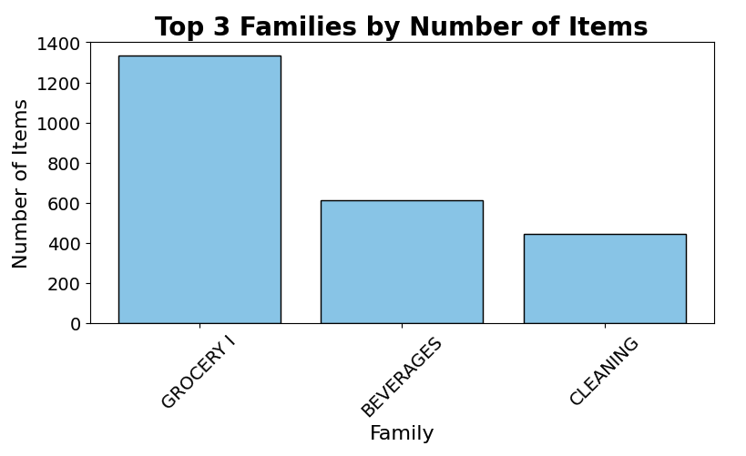
Product Categories Overview
The largest product family is Grocery I, followed by Beverages and Cleaning.
Indicates the store’s focus on everyday household products.
These categories contribute the most to total item count and sales volume.
➡️ Insights here help identify key drivers for forecasting demand.

Slide 4
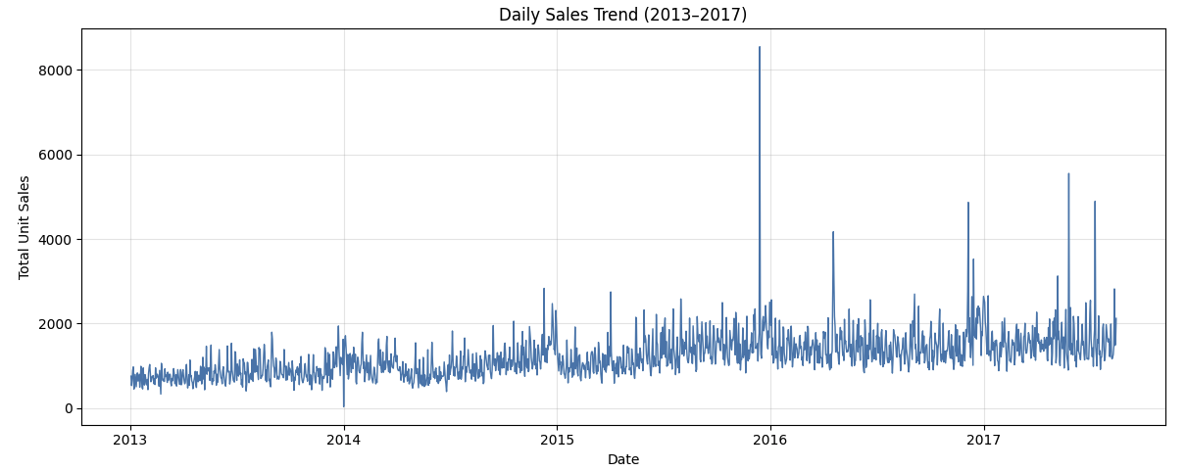
Sales Trend Overview (2013–2017)
Notes:
Daily sales fluctuate around a relatively stable baseline from 2013–2015.
A significant spike is observed in mid-2016, likely due to large promotions, restocking, or special events.
Regular weekly and yearly seasonality is visible, suggesting cyclical demand patterns.
These variations may influence forecasting accuracy if not modeled properly.

Slide 5


Forecasting Models Overview
Company Name

Slide 6
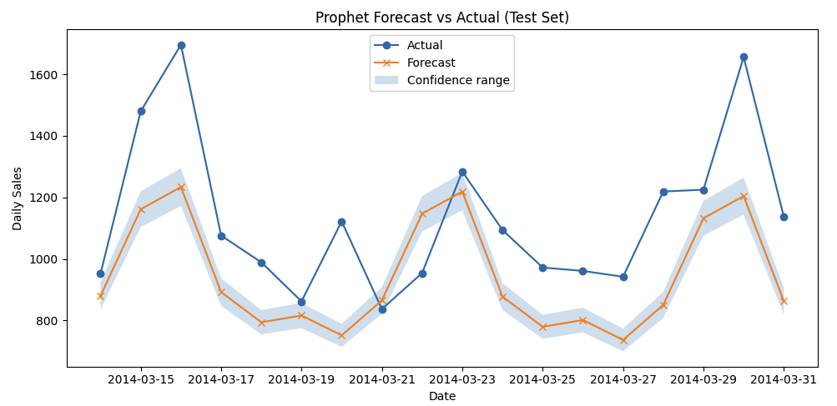
1st Model : Prophet
Notes:
Here, we can see the Prophet model’s predictions compared to the actual daily sales for the test period — from March 14 to March 31, 2014.
The blue dots represent the actual sales, while the orange line shows Prophet’s forecast. The light blue shaded area is the confidence interval, meaning Prophet’s uncertainty range.
Overall, the model follows the general up-and-down pattern quite well. It slightly underestimates the peaks, especially around March 16 and March 30, which are likely due to local demand spikes.

Slide 7

Evaluation Metric - Prophet
Prophet (Additive)
Fastest to train (0.16s)
MAE = 216.4 → average error quite high
RMSE = 252.6 → large deviations on peak days
Bias = –191.8 → tends to underpredict sales
Simple & fast, but misses sudden spikes
Notes:
Prophet performed fairly well, with:
MAE: 216.4
RMSE: 252.6
Bias: -191.8
This means the average error is around 216 units, and Prophet tends to slightly underpredict actual sales.
Even though the accuracy could be improved, Prophet’s advantage is that it’s fast to train (0.16 sec) and very interpretable — we can easily understand the trend and seasonality it captures.
> That was the Prophet model — fast but not very accurate. Let’s see how XGBoost compares.

Slide 8
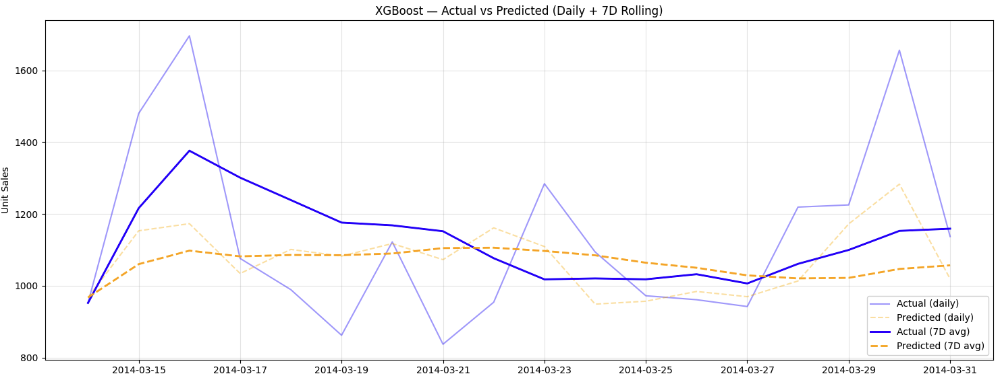
2nd Model : XGBoost
Notes:
XGBoost aligns closely with observed sales, showing stable short-term forecasts.
—-
This is the XGBoost model’s forecast compared to actual daily sales for the same test period, March 14–31, 2014.”
The light blue and orange lines show the actual and predicted daily sales, while the thicker lines represent the 7-day rolling averages — which help smooth out day-to-day noise.
We can see that XGBoost follows the general pattern of sales, but it tends to underestimate sharp peaks on certain days, like March 16 and March 30.
Because XGBoost uses engineered features such as holidays, promotions, and oil prices, it captures trend and seasonality relatively well — although it smooths out some volatility.

Slide 9

Evaluation Metric - XGBoost
XGBoost (Tuned)
Moderate training time (≈ 220 s)
MAE = 0.26 → lowest average error among models
RMSE = 1.90 → smallest spread of errors
Bias = –0.0088 → nearly unbiased predictions
✅ Most accurate and balanced overall.
Notes:
After tuning, the model performed better, with:
RMSE: 1.904
MAE: 0.259
Bias: -0.0088
It also trained much faster than LSTM (around 220 seconds), making it a good balance between performance and efficiency.

Slide 10
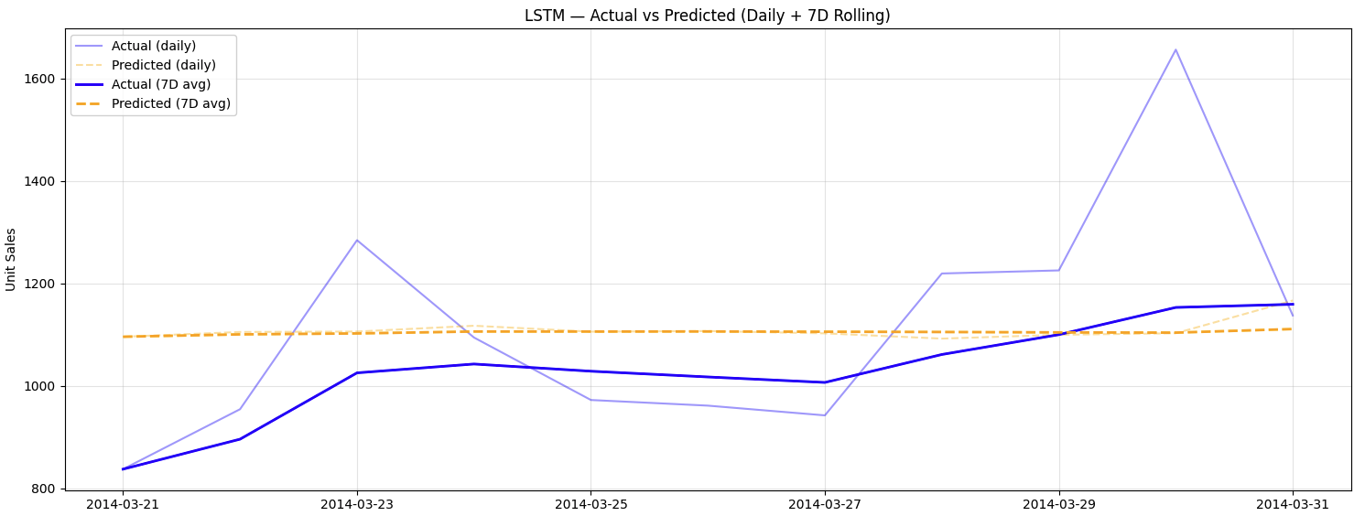
3rd Model : LSTM
Notes:
LSTM produces smoother curves but requires longer training time.
The LSTM model generates smoother predictions compared to the actual sales.
It captures the overall trend but fails to react to sharp peaks — meaning it underestimates sudden sales increases.
Despite that, the bias is close to zero, so it’s not systematically over- or underpredicting.
However, training takes significantly longer than Prophet or XGBoost. (around 11 minutes)

Slide 11

Evaluation Metric - LSTM
LSTM (Baseline)
Longest training (≈ 670 s ≈ 11 min)
MAE = 0.30 → slightly higher average error
RMSE = 2.09 → sensitive to large fluctuations
Bias = –0.0010→ almost no bias, predictions well-centered
Smooth trend capture but less responsive to sharp peaks.
Notes:
After tuning, the model performed better, with:
MAE: 0.3032
On average, the model’s predictions were off by around 0.3 units from the actual sales. This means the model’s typical error is small compared to the scale of sales data — quite decent performance
RMSE: 2.0901
The RMSE is higher because it penalizes large errors more strongly. This suggests the LSTM sometimes makes larger mistakes on certain days, possibly around peak sales days.
Bias: -0.0010
The bias is very close to zero, which means the model isn’t systematically overpredicting or underpredicting — it’s balanced on average.
Summary =
The LSTM model performed fairly well, with an average error of about 0.3 units per day.
It doesn’t show much bias, meaning it predicts both highs and lows fairly evenly.
However, the RMSE shows that the model sometimes struggles with sharp peaks, such as during high-demand days.”
Now, let’s look at the evaluation metrics side by side.

Slide 12
Metric Evaluation
Model | MAE | RMSE | Bias | Training Time
⚡ Prophet | 216.40 | 252.64 | -191.83 | 0.16 sec
🎯 XGBoost | 0.2575 | 1.9704 | -0.0088 | 3.49 sec
🧠 LSTM | 0.3032 | 2.0901 | -0.0010 | 670.94 sec
⚡ = fastest, 🎯 = most accurate, 🧠 = most complex
Notes:
So here’s a quick summary of how the three models performed.
MAE shows the average size of prediction errors — so lower is better.
Prophet’s MAE and RMSE are much higher than the others, which means it struggles to capture daily variations.
XGBoost has the lowest MAE and RMSE, meaning it predicts closest to the actual sales and handles spikes better.
> LSTM’s results are slightly worse than XGBoost, but the bias is very small, meaning it’s quite balanced — just slower to train.
> From a business perspective, planners could use these forecasts to manage inventory,
prepare for promotional peaks, and adjust supply based on expected demand.
Especially with XGBoost, they can refresh the model weekly to keep forecasts relevant
Overall, XGBoost gives the best trade-off between accuracy and training time.
—------------------------------------------------------------
MAE = Average size of the errors — how far predictions are from actuals, regardless of direction.
Makin kecil, makin baik
Prophet kamu punya RMSE ≈ 252, rasio RMSE/MAE = 252/216 ≈ 1.17 → bagus, berarti error-nya cukup stabil.
RMSE = Like MAE but penalizes large errors more strongly.
RMSE ≥ MAE selalu
Biasanya RMSE ≈ 1.1–1.5 × MAE kalau modelnya stabil.
Kalau RMSE jauh lebih besar dari MAE → berarti ada beberapa spike error besar.
Bias = Whether predictions are generally too high or too low.
Positif = overpredict, negative = underpredict
Ideal = sekitar 0 (netral)
—--------------------------- How to improve Prophet in real life?
Prophet is fast and interpretable but only uses time and sales data by default.
To improve performance, it should be combined with additional features such as oil prices, holidays, and promotions.
These regressors would help Prophet understand why sales change, not just when they change.
—------ which model performed the best?
Among the three models, XGBoost performed best overall.
It achieved the lowest error metrics — MAE and RMSE — while keeping bias close to zero.
Prophet was very fast to train but less accurate, since it only used date and sales without external features.
LSTM gave similar accuracy to XGBoost but required much longer training time, which makes it less efficient for this dataset.
—-- the model was easy or complex to use? 1. Prophet was the easiest to use — it only needed date and sales columns, and the results were interpretable with clear trends and seasonality.
2. XGBoost and LSTM were more complex because they required additional feature engineering and data preprocessing, but they produced more accurate results.
3. LSTM was the most complex overall since it needed 3D reshaping, scaling, and longer training time.

